Slide 1
DOM and CSS
Presented in Nov 2015 for NCU by Doug Sherk

Slide 2
This talk targets all 3 learning types
For visual learners: slides, analogies, live demos
For audio learners: talking
For kinesthenic (learn by doing) learners: code available on GitHub to follow along with
To GitHub repo to follow along: https://github.com/DouglasSherk/Talk_DOM-and-CSS

Slide 3
Purpose of this talk
Introduce you to the DOM and CSS
Focused on high-level understanding and mechanics
Understanding of how and when CSS is applied to style webpages
Exposure to most commonly used CSS properties, so that you can style your pages
Give you ways to tackle problems that you encounter with CSS
Not going into best practices in large detail
Should be about an hour long, with a 5 minute intermission

Slide 4
Chapter 1: The DOM

Slide 5
The DOM
You can think of the process of building a website as similar to building a house
“DOM” short for “Document Object Model”
HTML gets interpreted by the browser into the DOM
Just like HTML, the DOM is a tree structure
The DOM has state: it supports CRUD (creation, retrieval, update, deletion) operations

Slide 6
HTML
DOM
DOM w/ CSS (Web page)
Browser
JavaScript
CSS

Slide 8
DOM vs CSS
The lines between the DOM, CSS, and JS may look a bit blurry.
That’s because they are.
We’ll show some of this later.

Slide 9
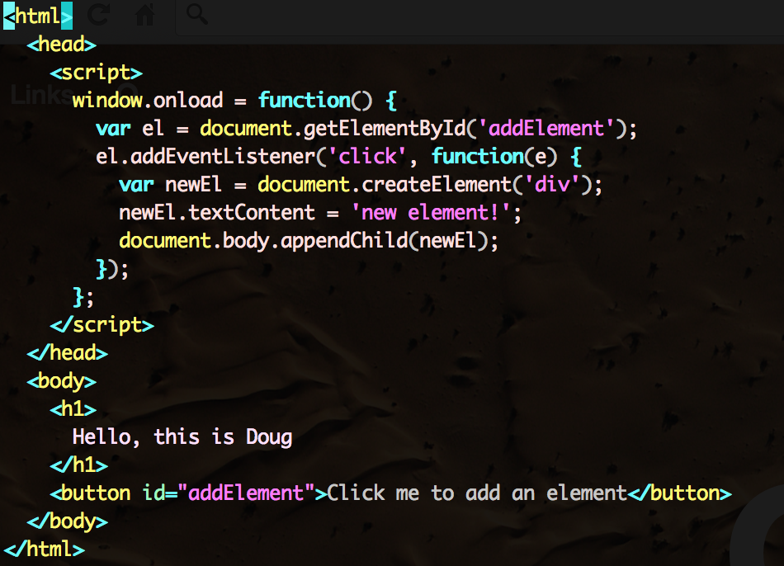
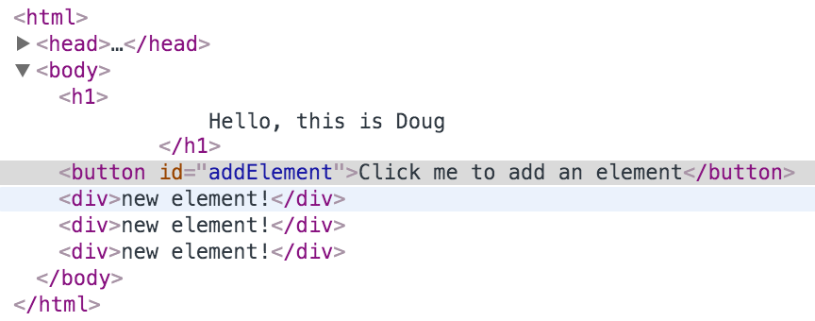
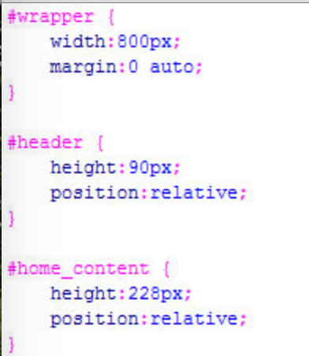
HTML, DOM, CSS typical look
HTML
DOM
CSS

Slide 10
Why is the DOM important? It…
allows us to dynamically structure content,
gives us targets for CSS and JS to operate on,
provides real tangible form to HTML.

Slide 11
Example 1: Adding an element to the DOM
In this example, we’re going to add an element to the DOM and see:
The HTML stays the same.
The DOM has the new element.
Go to http://jsfiddle.net/ja6xL6p2/
Aside tutorial: how to use JSFiddle

Slide 12
Chapter 1: The DOM - Summary
The DOM, HTML, and CSS are all distinct pieces of a website.
HTML is a text representation of the structure of a website, like a blueprint for a house.
The DOM is a stateful tree for the structure of a website, like a house frame.
CSS is the decoration for a website, like the walls, windows, paint, etc.

Slide 13
Chapter 2: DOM Attributes

Slide 14
How do we use the DOM?
To build the DOM, we just write HTML, and the browser converts it into the DOM for us.
But we need a way to bind the DOM to CSS and JS, so that we can style it and manipulate it.
Think of it this way: suppose we have a house. How do we tell the browser to paint a specific wall in the house blue?

Slide 15
Method 1 to use the DOM: Style attributes
This bypasses the need to bind to the DOM entirely when styling
Attributes are tags that you add to your HTML, like this:
<div bgcolor=“#fff”> → this makes the div element have a white background.
You can style DOM elements using attributes.
There are several problems with this approach.
Not everything you would want to style can be styled this way. E.g. transparency.
Clutters the HTML.
Best practices [!]: keep styles in CSS files whenever possible.

Slide 16
Method 2 to use the DOM: Classes and ID’s
To bind JS and CSS to the DOM, we almost always use this method.
“ID” and “class” attributes are effectively labels for elements, so that JS and CSS can target them.
An “ID” is an attribute applied to an element to uniquely reference it.
A web page should have no more than one instance of each ID.
We rarely style elements using “ID” tags.
A “class” is an attribute applied to an element to uniquely reference it and other elements that are like it.
A web page can have any number of elements with the same class.

Slide 17
Applying ID’s and classes to elements
ID’s and classes are attributes.
ID: <div id=“myDiv”>
Elements can only have one ID
Class: <div class=“myClass”>
Elements can have any number of classes, like this:
<div class=“myClass myOtherClass”>

Slide 18
Example 2: Targeting elements with ID’s and classes
In this example, we’re going to target some elements in the DOM by their ID’s and classes and see:
How changing styles for one class can affect several elements in the DOM
How elements can be targeted by class and ID
Open http://jsfiddle.net/05c3q4os/

Slide 19
Chapter 3: CSS Selectors

Slide 20
How do we target DOM elements from CSS and JS?
When we’re working with the DOM, we want to be able to bind CSS and JS to it.
This is where CSS selectors come in.
CSS selectors are an entire language.

Slide 21
CSS Selector Basics
You can select elements using the following basic components of a CSS selector.
Class – the “.” tag, e.g. “.myClass”
ID – the “#” tag, e.g. “#myID”
Element type – the element name, e.g. “div”
Attribute – the “[attrname=]” tag, e.g. “[data-toggle=‘true’]”
Cheat sheet: http://www.cheetyr.com/css-selectors

Slide 22
CSS Selector Basics
You can also string together selectors to select only elements that follow a certain hierarchy.
Any descendant: .myClass .myDescendant
Child only: .myClass > .myChild
(Less useful) direct sibling: .myClass + .myDirectSibling
(Less useful) any sibling: .myClass ~ .mySibling

Slide 23
CSS Selector Basics
You can string together multiple CSS selectors at the same level of the hierarchy.
Select all div elements with the class “myClass”: div.myClass
Select all input elements with the attribute type=“checkbox” and class “disabled”: input[type=‘checkbox’].disabled

Slide 24
CSS Selector Basics
Finally, you can bring this all together to select some really complicated stuff.
All input elements of type “text” that have the class “formInput”, and are direct descendants of any elements with the class “form” that also have the attribute data-submittable=‘true’: .form[data-submittable=‘true’] > input[type=‘text’].formInput

Slide 25
Example 3: Using CSS selectors
In this example, we’re going to use CSS selectors to target some elements. As a class, we’re going to:
Observe how subtle changes in selectors can completely change the selected elements.
Go through how to select each element in the provided HTML as specifically as possible.
Open http://jsfiddle.net/nonm829v/

Slide 26
Chapter 4: Units and Sizing

Slide 27
Units Overview
We use units to calculate how big or small anything displayed should be.
Units are used in dimensions (width, height), font sizes, margins, padding, positioning, and other places.

Slide 28
Types of Units
“px”: Pixels. Exact size, doesn’t really depend on how big the screen is, or anything else.
“em”: A factor of the current font size. For example, if the current element has `font-size: 16px` set, then `1em = 16px`.
“rem”: A factor of the root font size. For example, if the <html> element has `font-size: 20px` set, and the current element has `font-size: 16px` set, then `1rem = 20px`.

Slide 29
Example 4: Types of Units
In this example, we’re going to look at how units appear when rendered.
We’ll look at how changes in `font-size` for elements changes, or doesn’t change, `px`, `em`, and `rem` measurements.
Open http://jsfiddle.net/xnt1d8oh/2/

Slide 30
Chapter 5: Styling using CSS

Slide 31
Styling Content with Properties
CSS is styled using “properties”.
Properties are associated with CSS selectors in CSS files.
E.g. .myClass { color: white; }
This will make any element with class “myClass” have white text.
“.myClass” is the CSS selec tor, “color” is the property, and “white” is the property’s value.

Slide 32
Common Visual CSS Properties
“color”: Font color.
“background”: Background color and/or image. Can be repeating, positioned; very flexible.
“font-weight”: Thickness of the font.
“font-style”: Styling of fonts, e.g. ‘italic’, ‘underline’.
“text-align”: Aligns text within an element.
“font-size”: Size of a font within an element.
“opacity”: Transparency of an element.

Slide 33
Example 5: Using visual CSS properties
In this example, we’re going to observe what happens when we apply some visual CSS properties to some elements.
We’ll look at how we can change some of them, and the elements change as well.
Open http://jsfiddle.net/dn5evtu4/

Slide 34
Common Layout CSS Properties
“display”, “position”, “float”: Methods of deciding how elements are to be laid out in a document, and relative to other elements.
“z-index”: For position:fixed and position:absolute, determines how an element will be overlapped by other elements. Think of a stack of cards.

Slide 35
Possible values for “display”
“block”: Default for <div> elements. More or less puts the element on its own line, and gives it whatever space inside that it wants.
“inline-block”: Default for <img> elements. Puts elements on the same line, but gives their box whatever space inside that it wants.
“inline”: Default for text-based elements, like <p> and <a>. Puts the element on the same line as other elements, and shrinks it to fit its contents.
“none”: The browser doesn’t render the element at all, or even factor it into layout.
… many more that are generally less useful.

Slide 36
Possible values for “position”
“static”: Default for all elements. Uses the browser’s regular layout rules to calculate where the element should be positioned.
“relative”: Similar to static, but allows shifting the element using “left”, “right”, “top”, “bottom” properties.
“absolute”: Positions the element by static numbers entered by the developer. Relative to the closest parent with `position: relative`, or the window if there are parents with this property.
“fixed”: Positions the element by static numbers entered by the developer, but relative to the viewport. With this setting, when you scroll, the element will stay on your screen.

Slide 37
Possible values for “float”
“float” tells the browser to take an element out of its parent container and render it at the same level as that parent.
“none”: Default for all elements. Renders the element within its parent container.
“left”: Takes the element out of its parent container and puts it before its parent.
“right”: Takes the element out of its parent container and puts it after its parent.

Slide 38
Example 6: Using layout CSS properties
In this example, we’re going to observe what happens when we apply some layout CSS properties to some elements.
We’ll look at how we can change some of them, and the elements change as well.
Open http://jsfiddle.net/vv09c3gL/1/

